Slide 1


Meet and Assist Services at Arturo Merino Benítez International Airport, Santiago, Chile

Slide 2
INDEX
PRIMECLASS CIP SERVICE
    WHO ARE WE?
    WHAT IS PRIMECLASS SERVICE?
    DEPARTURE SERVICE
    ARRIVAL SERVICE
    PASSENGER & AIRPORT BENEFITS
    LATIN AMERICA BENCHMARK
    MEET & ASSIST SERVICES AT SANTIAGO AIRPORT
    IMPACT FOR MOP

Slide 3
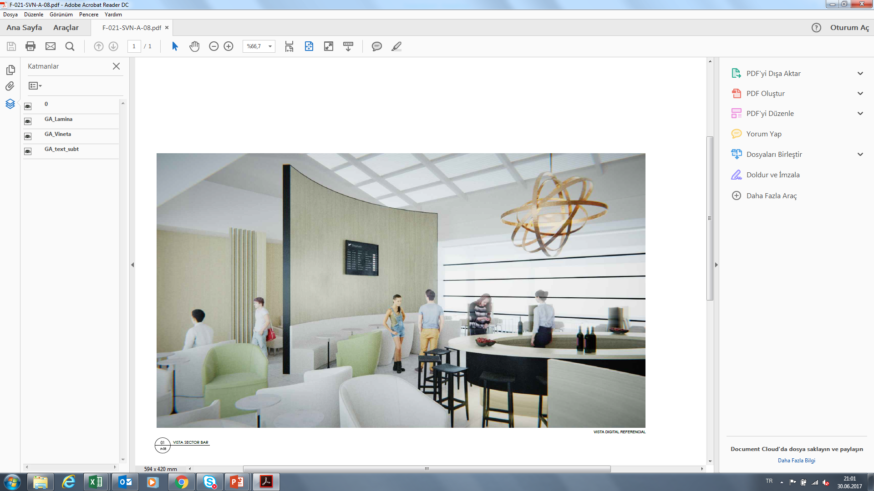


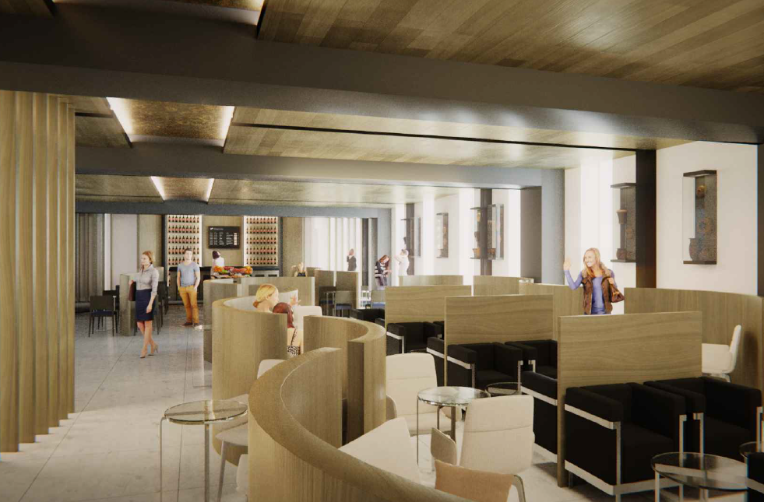
Who are we?
Our Development Strategy: Latin America
Primeclass Pacífico es el resultado de una sólida alianza entre TAV Operations Services y Servicios Aeroportuarios S.A.
Primeclass Pacífico fue recientemente reconocida, en abril de 2017, como la empresa que estará a cargo de la gestión de servicios de dos salones y del nuevo servicio Meet & Assist, en el Aeropuerto Internacional Comodoro Arturo Merino Benítez de Santiago.
PP iniciará sus operaciones en Octubre de 2017.
TAV OS aportará desde su amplia trayectoria, sus conocimientos operacionales y financieros, tanto para crear servicios Meet and Assist en América Latina, como para generar nuevos flujos de ingresos, por ejemplo, mediante la obtención de auspicios. También entregará su exitosa experiencia en la implementación de procesos y nuevas tecnologías.
SASA tiene una larga trayectoria y gran conocimiento de los mercados locales y regionales de América Latina. Sus canales de ventas se han desarrollado fuertemente a través de alianzas con bancos y otras instituciones, junto a su experiencia de más de 14 años operando en aeropuertos chilenos.

Slide 4
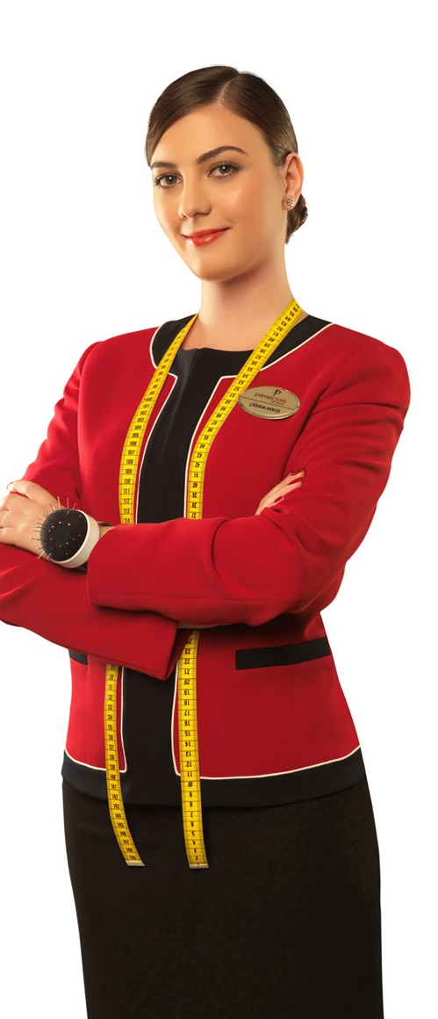
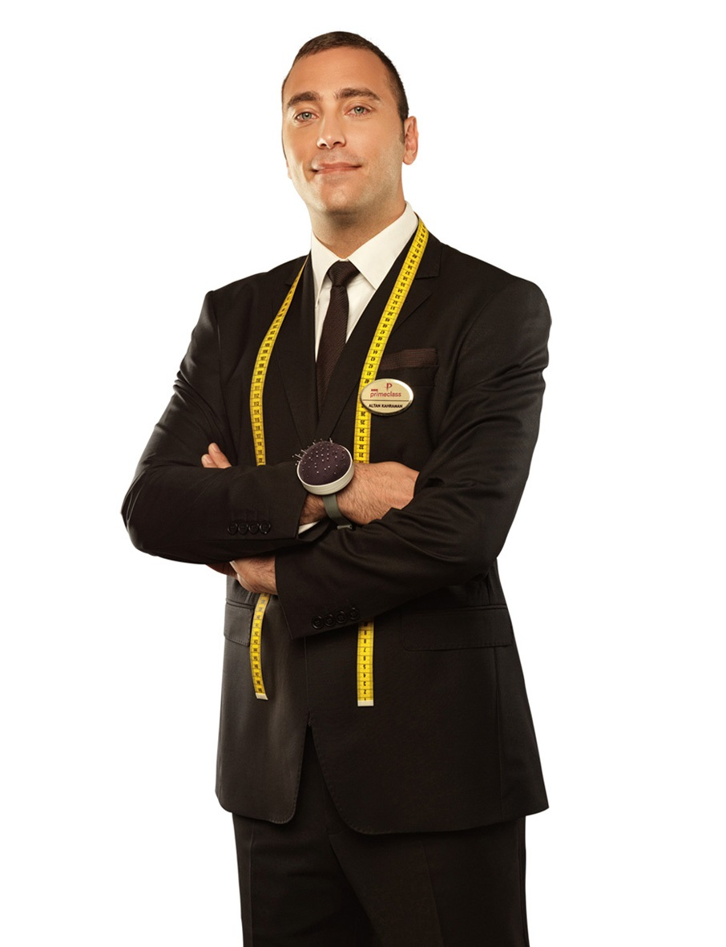
What is primeclass service?
“primeclass” offers exclusive CIP-VIP assistance service at the airports before and after flight through its professional team of employees and a wide range of other services during flight to present a comfortable and privileged travel experience.
“primeclass” combines Chilean hospitality and professionalism and provides service to the passengers who prefer comfort and speed, expect privilege and require special attention (disabled, unaccompanied child, transit passengers, etc.).
“primeclass” offers;
• Greeting at the entrance of the airport or at flight gate by an exclusive assistant,
• Porter services,
• Exclusive assistance during all flight and security transactions,
• Fast tracks,
• Enjoying the time prior to your flight at the lounges.
The service is completed once you are accompanied by your exclusive assistant to the flight gate/terminal exit.

Slide 5
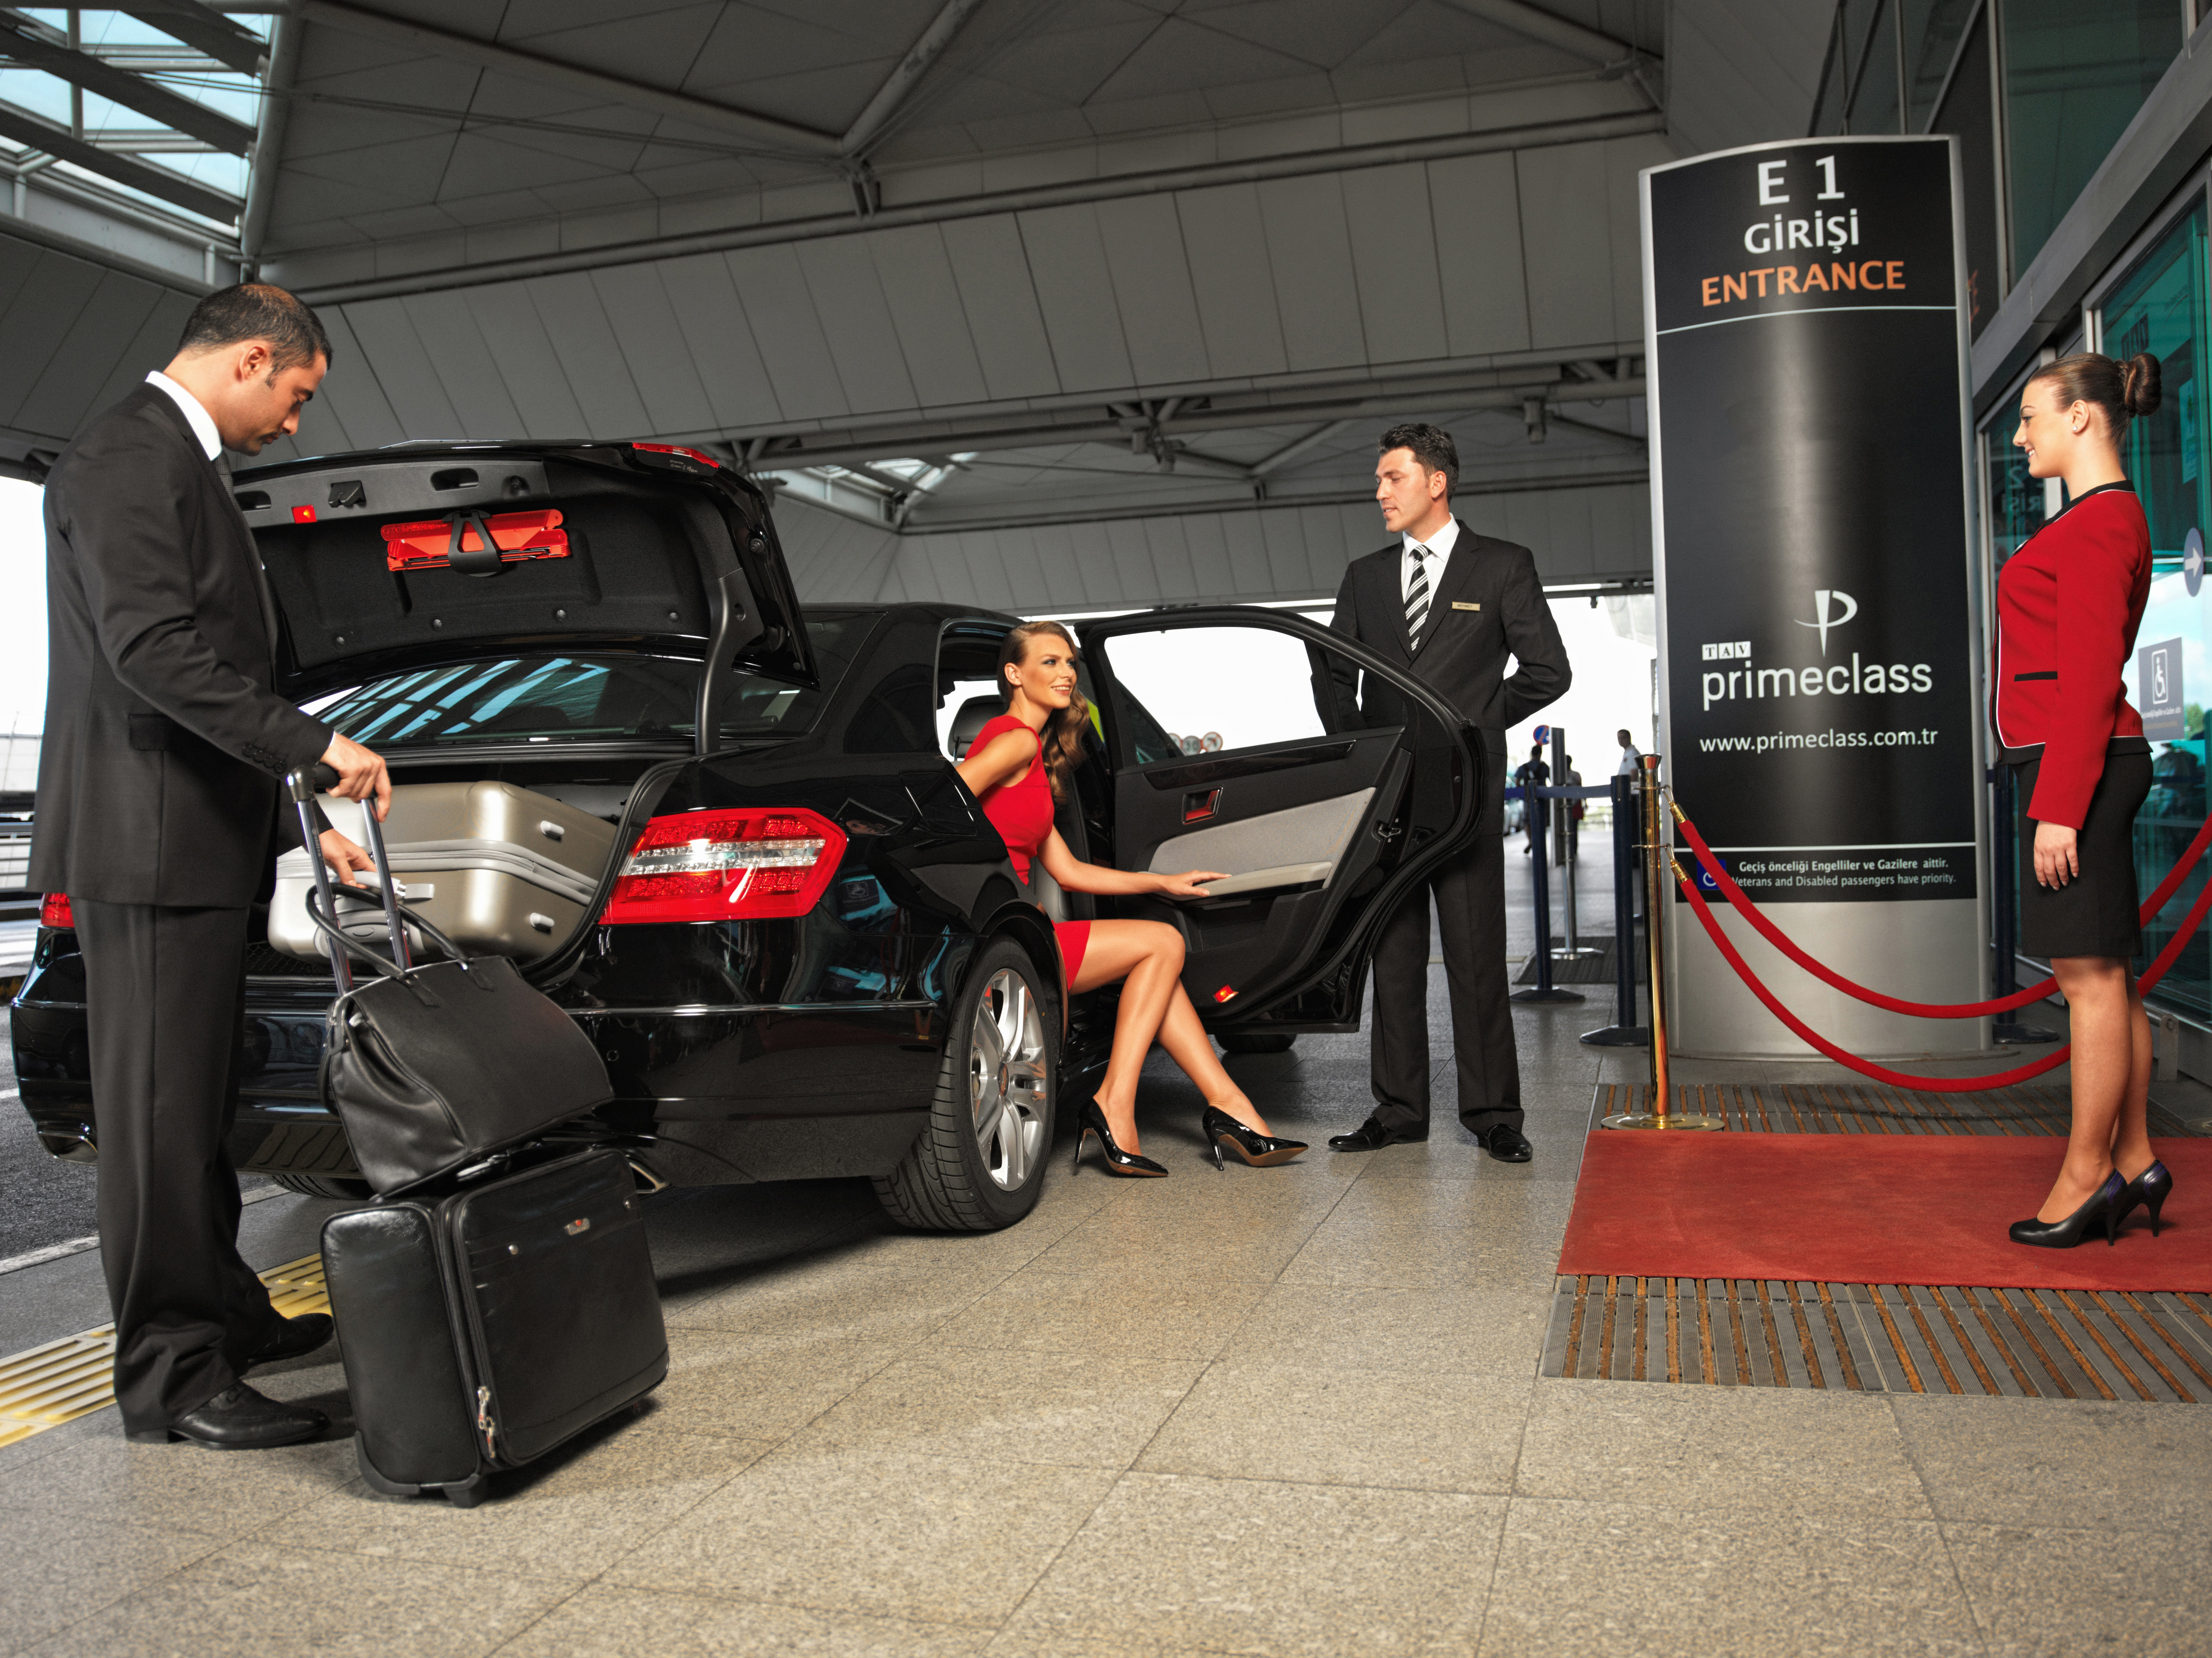
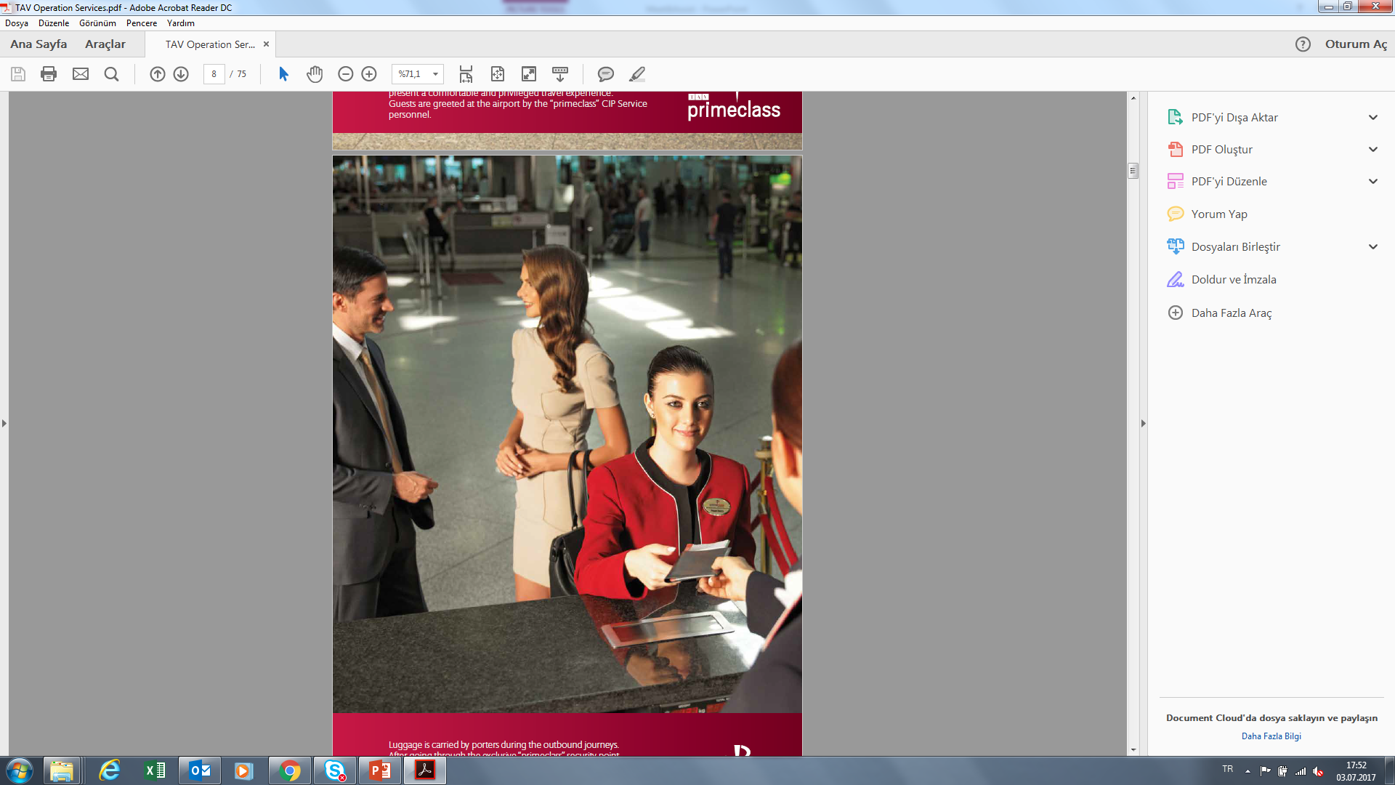
What is primeclass service?
Departure Service
Guests are greeted at airport by Primeclass Pacifico personnel.
Luggage is carried by porter during the outbond journey. After going through to terminal, all check-in are completed at contracted airlines businessclass counters in the company of Primeclass pacifico personnel.

Slide 6
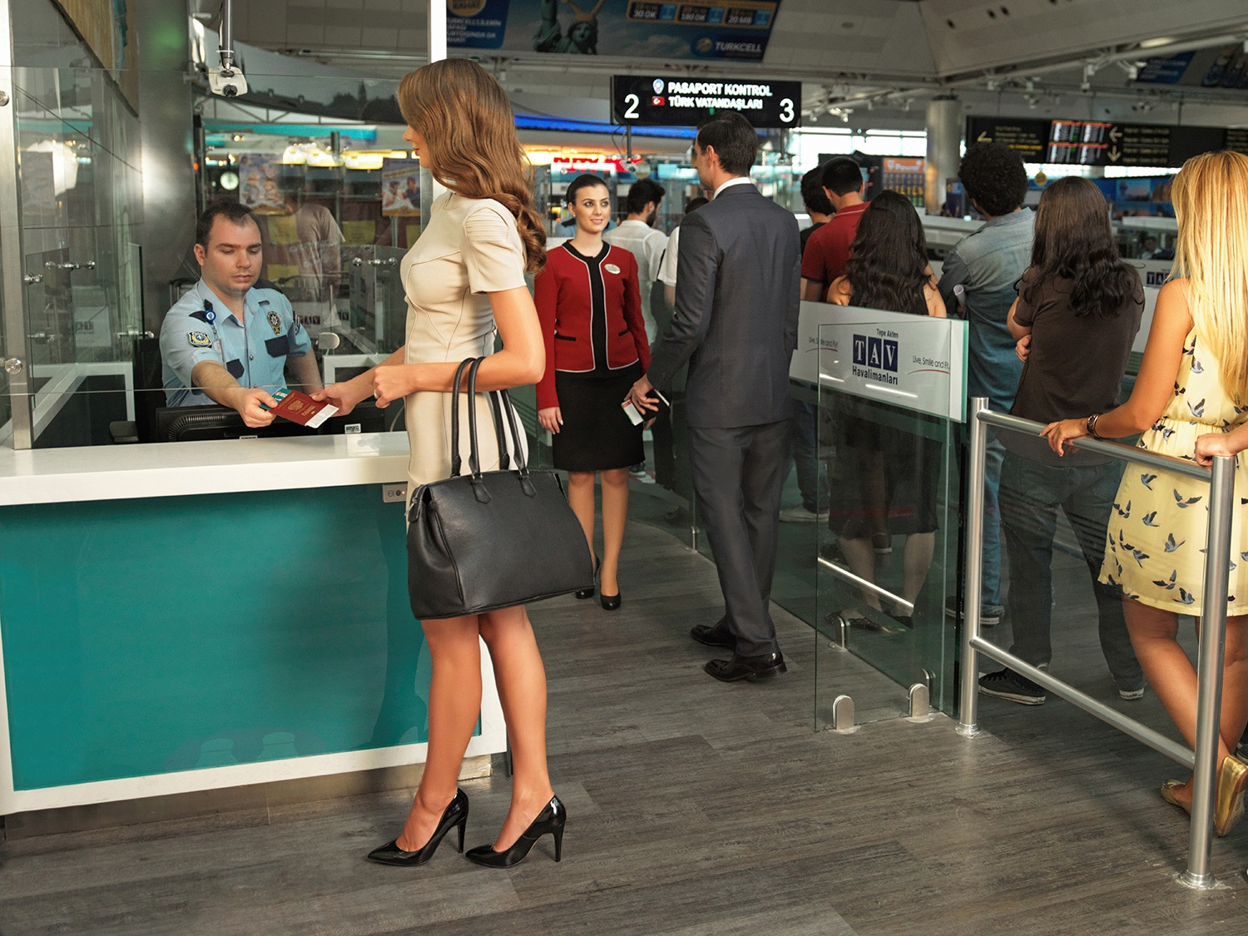
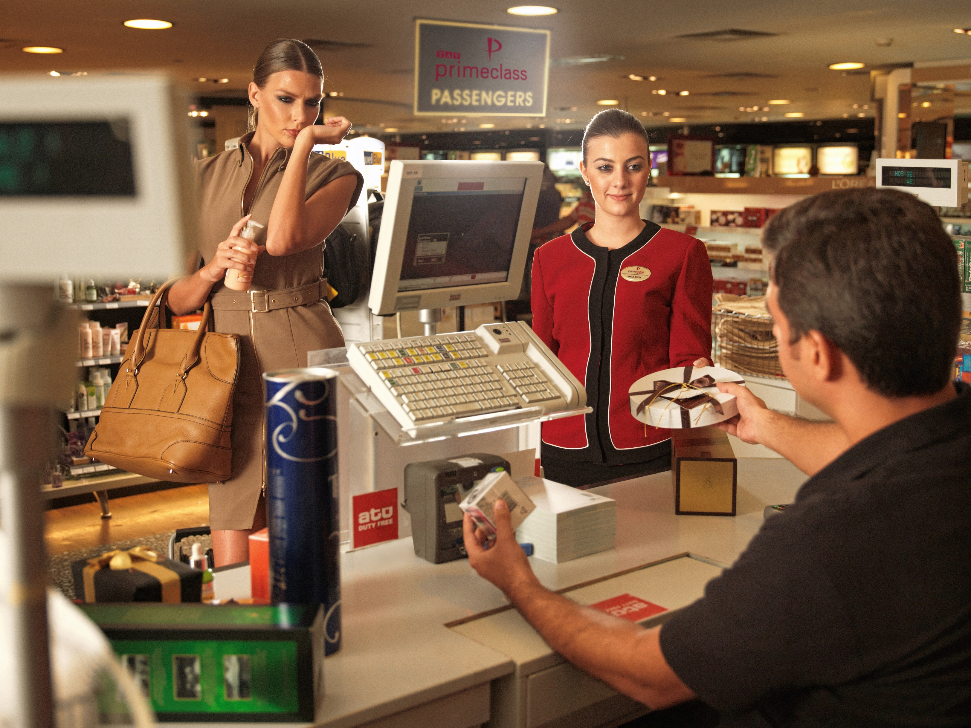
What is primeclass service?
Departure Service
Passport / security transactions are also handled quickly at the exclusive points.
Guests enjoy a stress-free shopping through the personnel assistance service, using the private “primeclass” privileged payment points allocated for them.

Slide 7
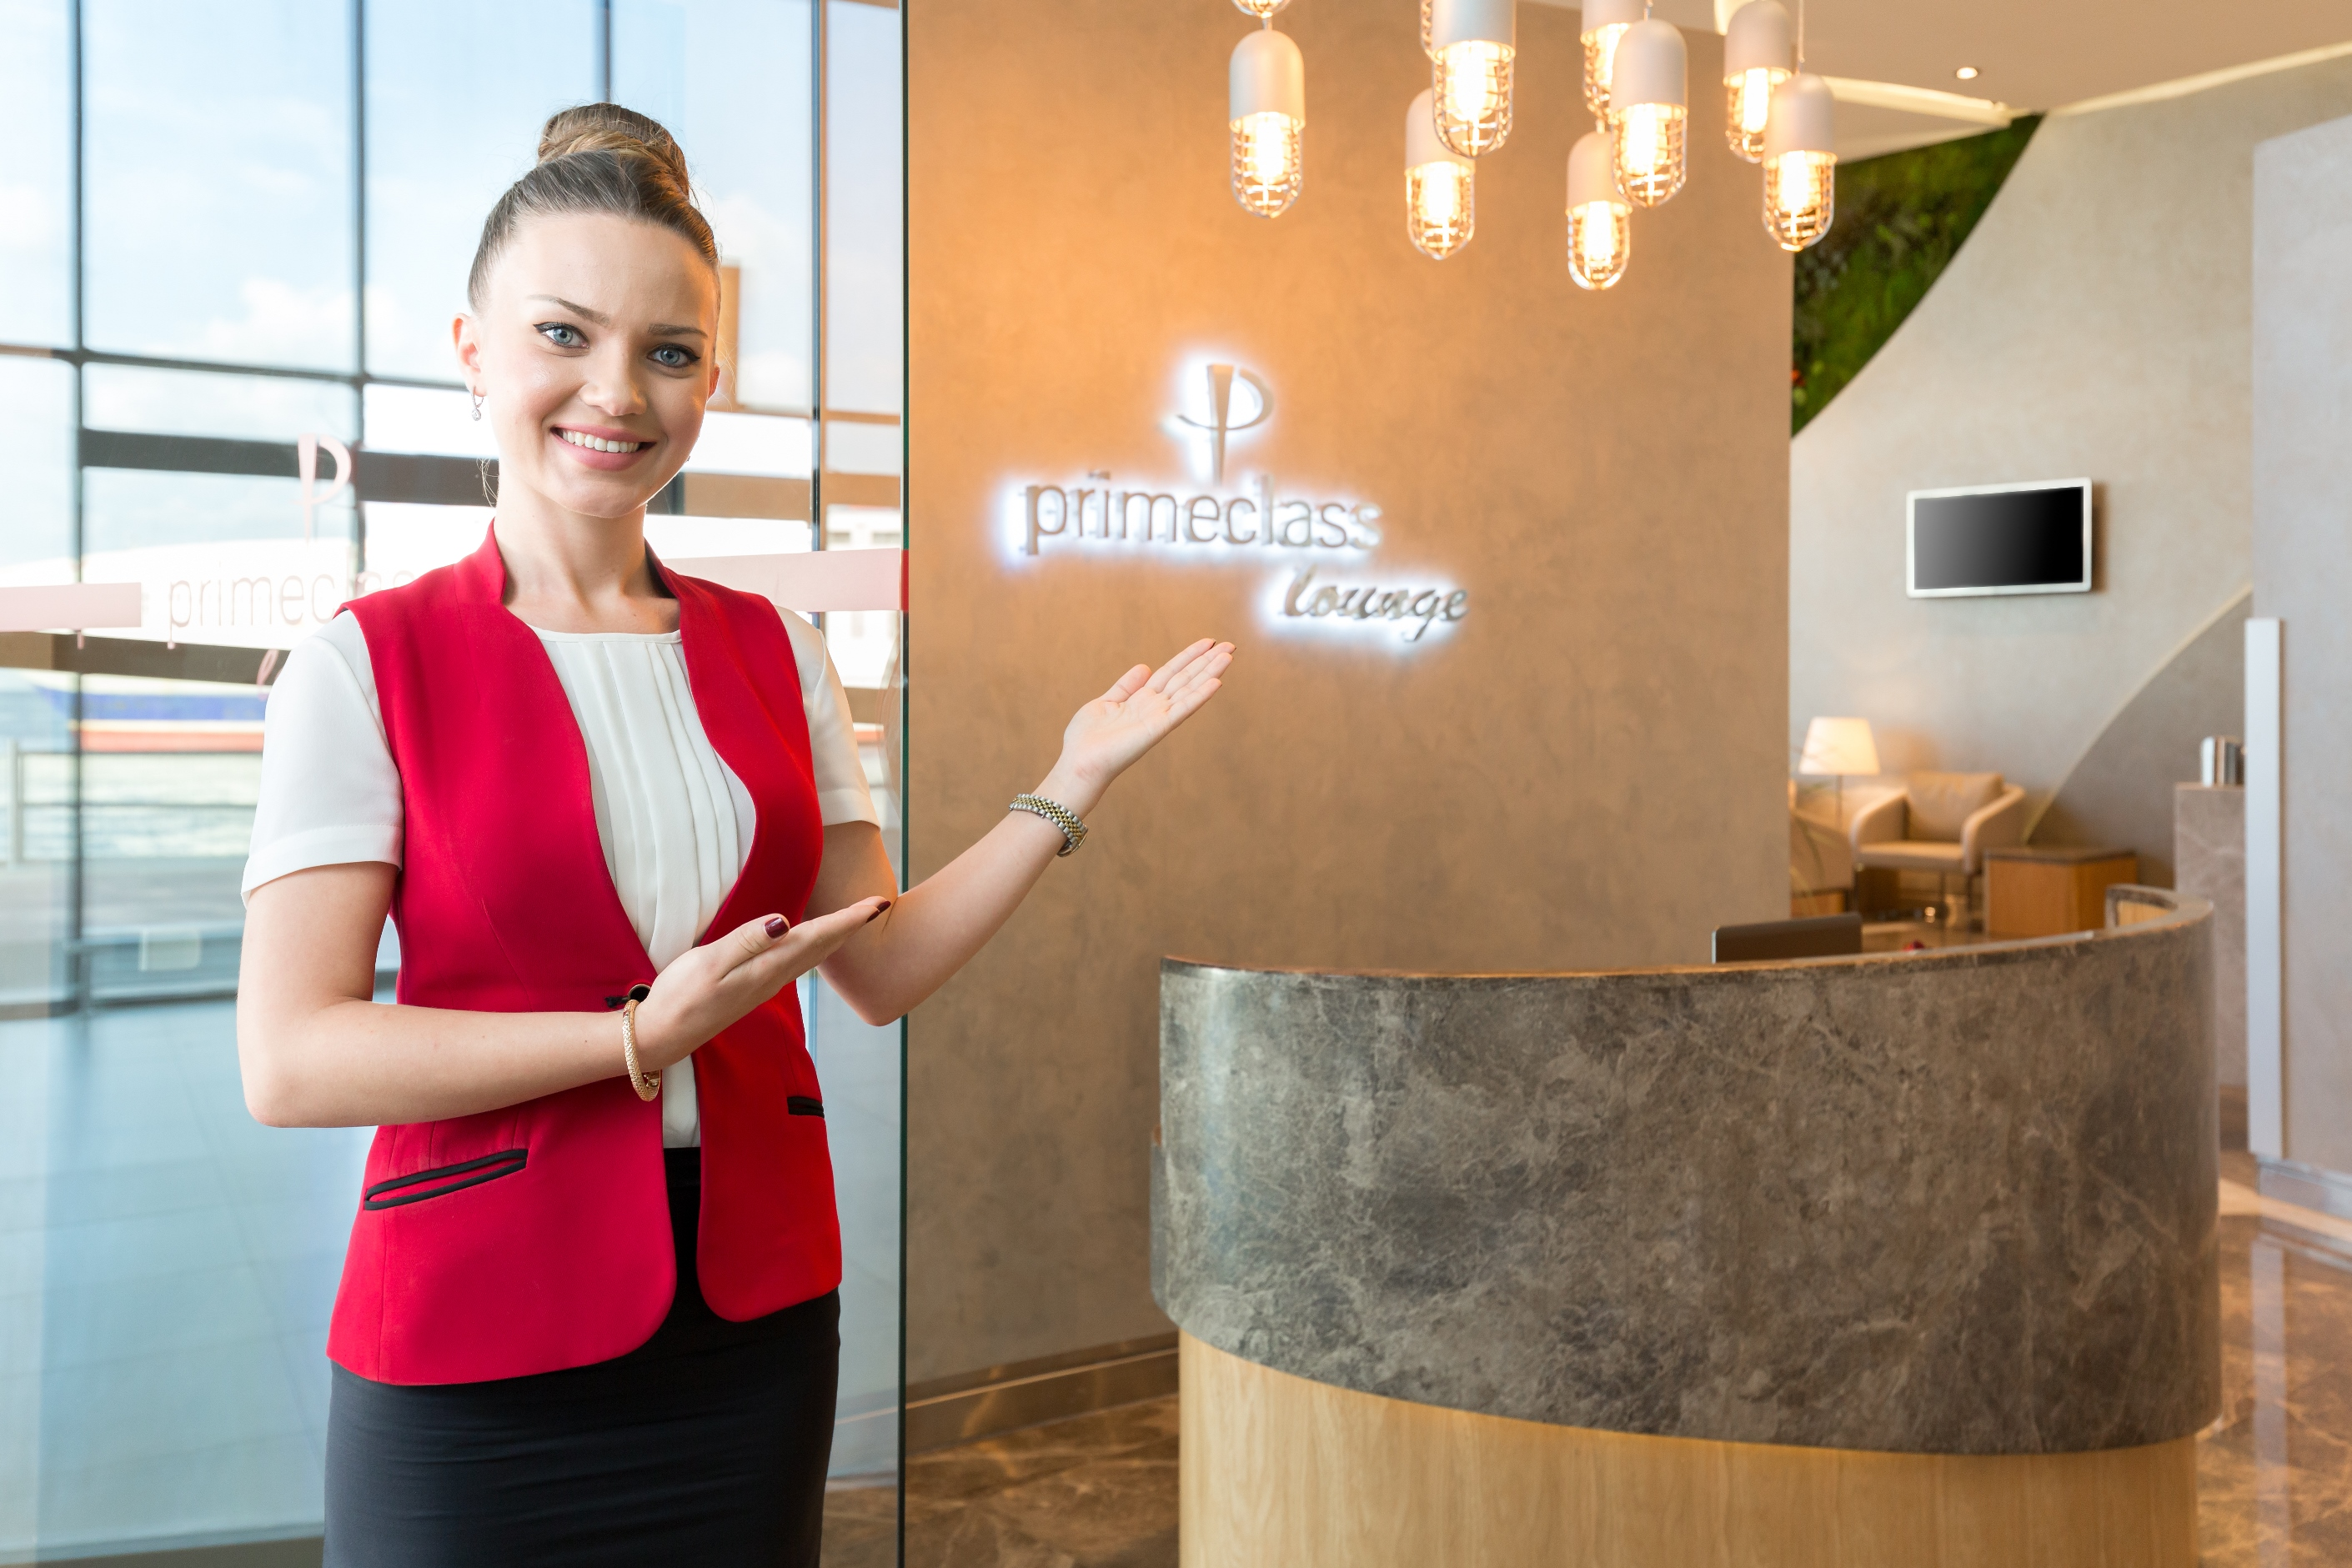
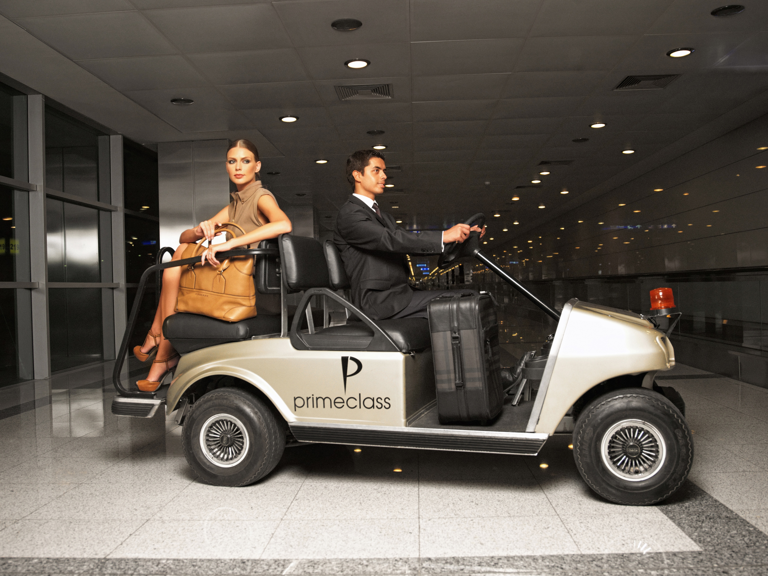
What is primeclass service?
Departure Service
Guests can use the lounge to relax and rest in a peaceful environment
They can continue working in an office environment, use the internet and
Enjoy the unlimited and delicious complimentary snacks while reading or
Watching TV.
Primeclass Cıp personnel will monitor guest fligth,on baording time will be companied to the gate by buggy car.
Upon demand, Embarked at the gate of the aircraft by special apron vehicles “primeclass” passengers continue enjoying the comfort as they are transferred from terminal to the apron.

Slide 8
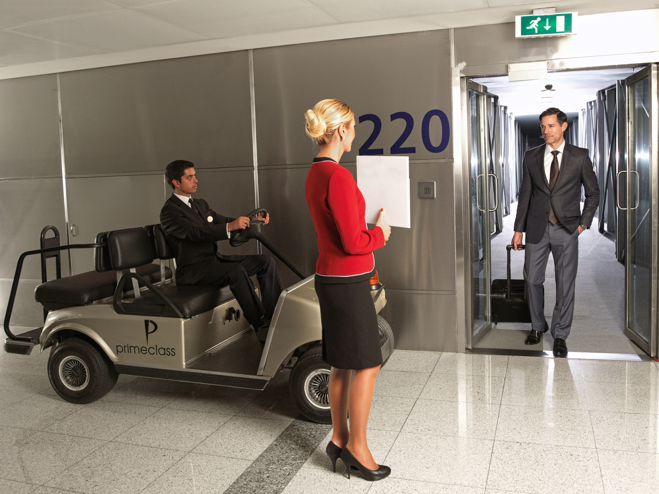
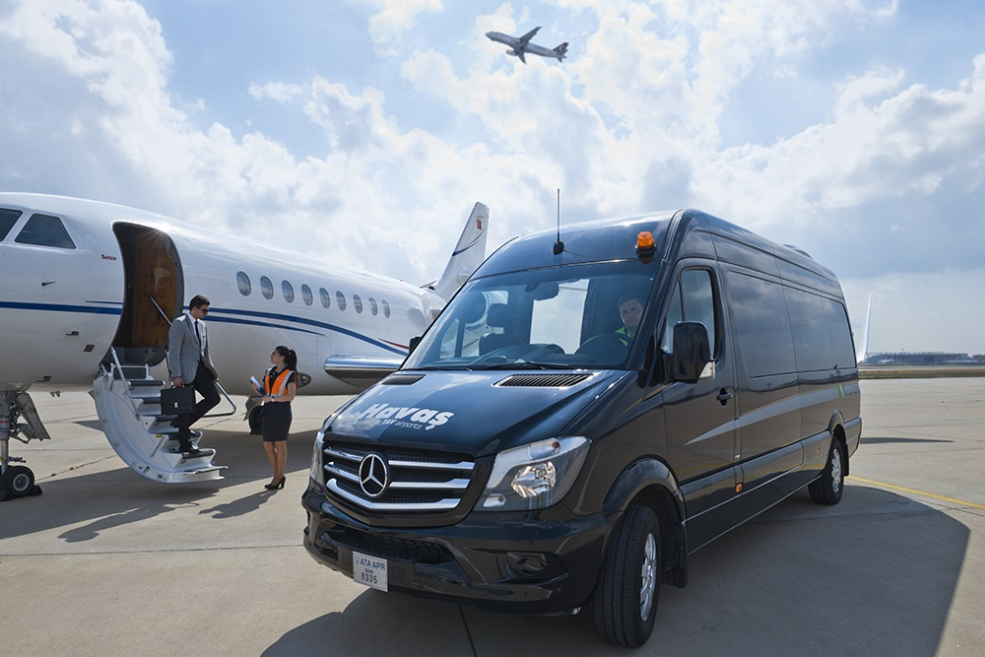
What is primeclass service?
Arrival Service
During arrival, primeclass privilege starts with the greeting of guests
by an hostess and a porter at the flight gate.
Guests are picked up from the flight gate with the bugycar in the accompany of the private assistants.
Upon demand,
Greeted at the gate of the aircraft by special apron vehicles “primeclass”
passengers continue enjoying the comfort as they are transferred from
the apron to the terminal.

Slide 9
What is primeclass service?
Arrival Service
Passport / security transactions are also handled quickly at the
exclusive passpoint.
Guests enjoy a stress-free shopping through the personnel assistance service, using the private “primeclass” privileged payment points allocated for them.

Slide 10

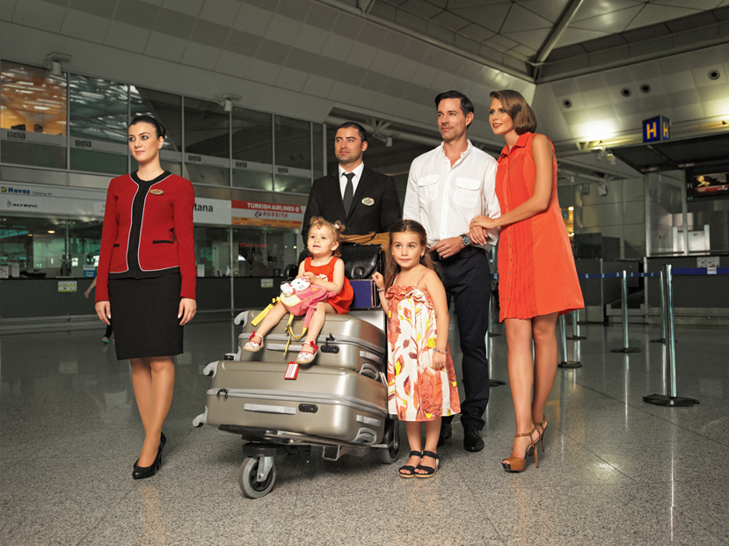
What is primeclass service?
Arrival Service
Guests can use the lounge to relax and rest in a peaceful environment while primeclass personnel and porter collect the luggage.

Slide 11
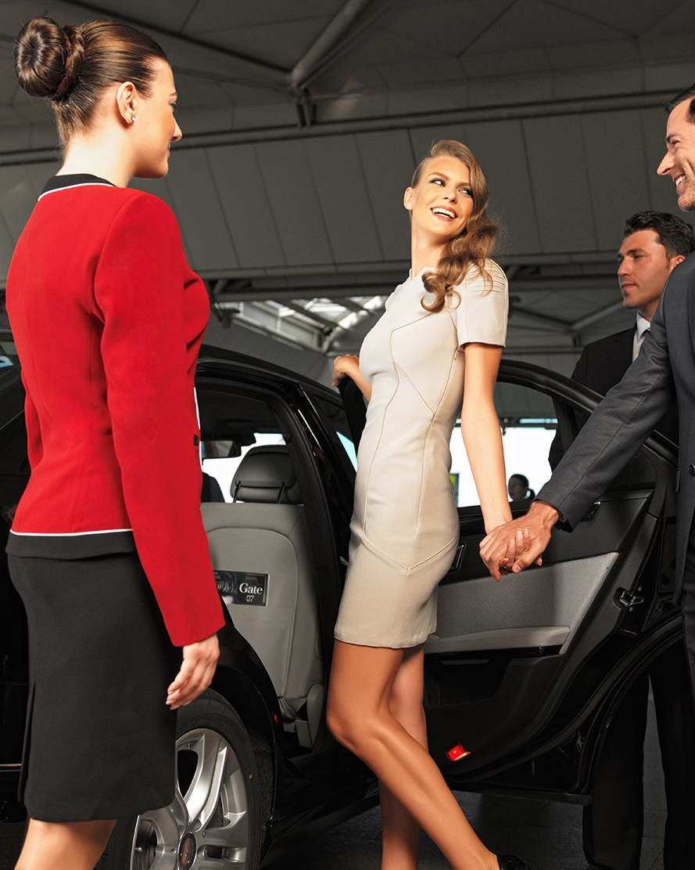
What is primeclass service?
Arrival Service
Primeclass personnel accompany to guest vehicle.

Slide 12
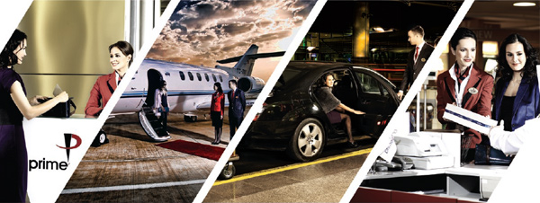

Passenger & Airport Benefits
Passenger Benefits
Comfort
Speed
Feeling of VIP
Saving Time
Easier Transactions
Feeling of less stress
Enjoyable Trip
Smart Solutions
Airport Benefits
Innovative Airport
Passenger Satisfaction
More Comfortable Airport
World Standard Service
Good Reputation
Increase Commercial revenues
Added Value

Slide 13
Latin America Benchmark
 | SAO PAOLO | RIO DE JANEIRO | BUENOS AİRES | PANAMA CİTY | BOGOTA
Official Website | No Information | Departure: 370 USD Arrival: 370 USD No Fast track at passport control | Departure: 400 USD Arrival: 400 USD No Fast track | No Information | No Information
Through Specialized Companies:
TAV primeclass | Departure 400 USD Arrival 400 USD | Departure 325 USD Arrival 325 USD | Departure 350 USD Arrival 350 USD | Departure 125 USD Arrival 125 USD
VIP 777 | Departure 590 EURO Arrival 590 EURO | Departure 480 EURO Arrival 480 EURO | Departure 620 EURO Arrival 620 EURO |  | Departure 400 EURO Arrival 400 EURO
Waiting information
To be updated

Slide 14

Meet & Assist Services at Santiago
Design the best service with Nuevo Pudahuel and MOP
Dedicated Entrance at the Terminal / Meeting Point
Business Class Check-in
Fast Track services at Customs
Fast Track services at Passeport control
Fast Track services at Security Checkpoint
Buggy Car authorization
Dedicated Payment at Dufy Free Shop
Discount at Duty Free / Restaurant
Apron Transfer (from Gate to Aircraft)
Arrival Lounge / Space

Slide 15
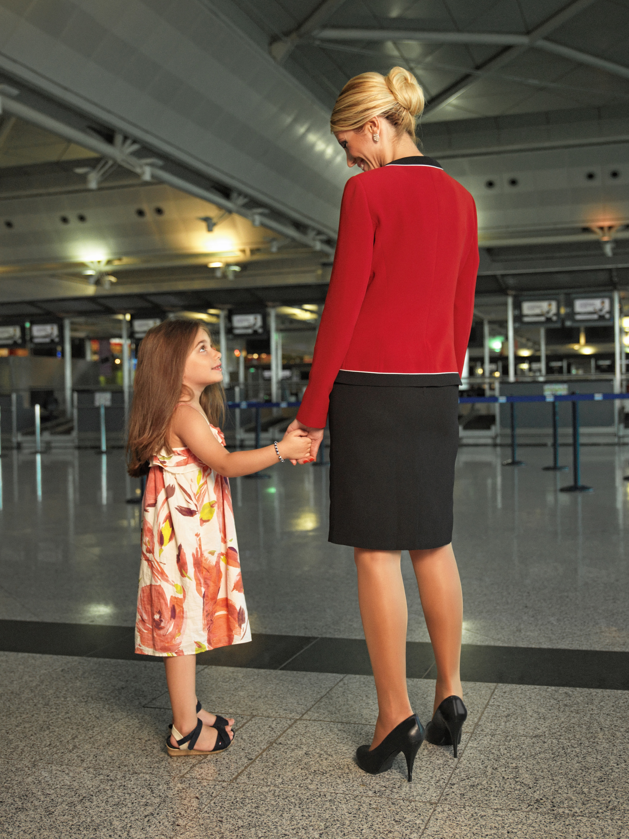
Meet & Assist Services at Santiago
Few Numbers
 | 2017 | 2018 | 2019 | 2020
Estimated Pax for Meet and Assist | 367 | 3.809 | 4.570 | 5.484
Expected Prices | International Departure | International Arrival | Domestic Departure | Domestic Arrival
Assist Service | 55 USD | 44 USD | 44 USD | 33 USD
Primeclass CIP Service | 110 USD | 88 USD | 88 USD | 66 USD

Slide 16
Impact for MOP
No impact for MOP
Proposition to use at a first step the fast track for pregnant woman and crew.
...

